Slide 1
DAHEL TECHNOLOGY
DATA ANALYTICS INTERNSHIP PROJECT
JANUARY COHORT GROUP 2

Slide 2
PROJECT TEAM MEMBERS
Love Eka
Norah Kanu Enun
Aroh Sylvester Chijioke
Ejike Ugochinyere Grace
Akpan, Ekeminiabasi Uduak
Amaka Odigwe

Slide 3
DAHEL DATA ANALYTICS CAPSTONE PROJECT(JANUARY COHORT)
PROJECT TOPIC: ANALYSIS ON NORTHWIND TRADERS,RETAIL AND SUPPLY CHAIN
INDUSTRY : E-Commerce,Retail and Supply Chain.
PREPARED BY: GROUP 2
Tools Used:
Power BI
SQL
Power Query
DAX
Data Modeling

Slide 4
NORTHWIND TRADING COMPANY
Executive Business Performance Review on
Sales, Customer, Employee, product, Inventory and Operations Analysis
Reporting Period: 2006 YTD

Slide 5
BUSINESS PROBLEM
Northwind Traders is a fictional specialty food import/export company widely used as a training dataset for learning business analytics. it captures the entire business cycle from suppliers providing products, to customers placing orders, employees processing those orders, and shippers delivering them,the data exists across multiple tables and systems.
Because of this, it can be challenging for managers or stakeholders to quickly see how the business is performing, identify which customers or products are most important, or monitor employee and delivery performance. Without a clear, view of the business, making timely and informed decisions becomes difficult, slowing down responses to issues and opportunities.
As a result, important decisions often take longer than they should and may not always be based on a complete picture of the business.

Slide 6
PROJECT OBJECTIVES
The objective of this project is to build an interactive business intelligence solution for Northwind Traders that transforms its scattered data into a unified, easy-to-understand dashboard system.
The solution aims to:
Provide a clear overview of overall business performance across sales, customers, products, and operations
Identify key trends such as best-selling products, top customers, and high-performing employees
Monitor logistics and delivery efficiency to ensure operational excellence
Enable decision-makers to take faster, more informed actions based on visual insights rather than raw data
Demonstrate the practical application of business intelligence tools in analyzing a complete retail and supply chain dataset
RESULT: A set of dashboards that allows Northwind Traders to easily track performance, spot opportunities, and make strategic business decisions.

Slide 7
PROJECT APPROACH
Data Cleaning (Power Query)
Data Modeling
DAX Measure Creation
Dashboard Development
Business Analysis

Slide 8
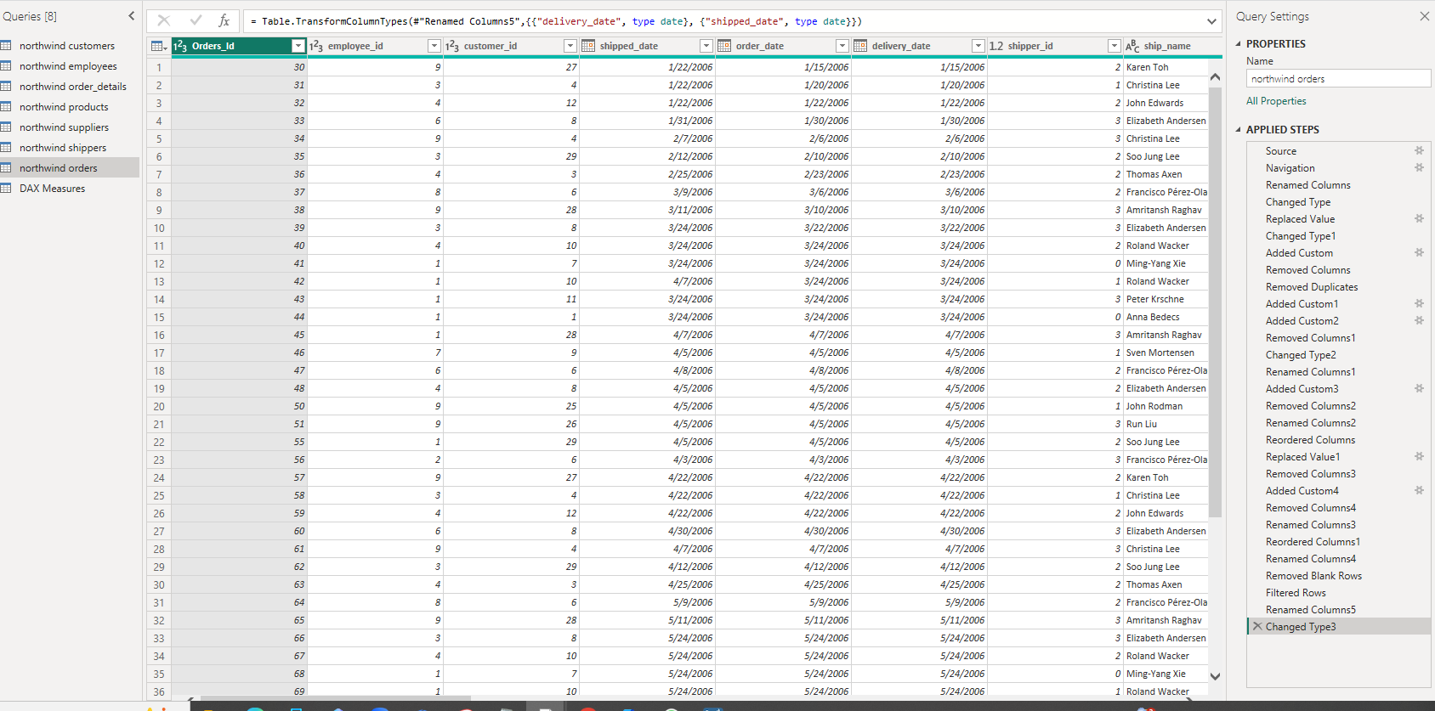
DATA CLEANING
The raw data was cleaned and prepared using Power Query to ensure accuracy and consistency across all datasets.
The process involved removing duplicate records, handling missing or null values, and correcting data types such as dates, numbers, and text fields. Irrelevant columns that were not required for analysis were removed to improve performance and clarity. In addition, tables were standardized and transformed to ensure proper relationships between customers, orders, products, employees, and shipping data. This step ensured the data was reliable and ready for analysis in Power BI.

Slide 9
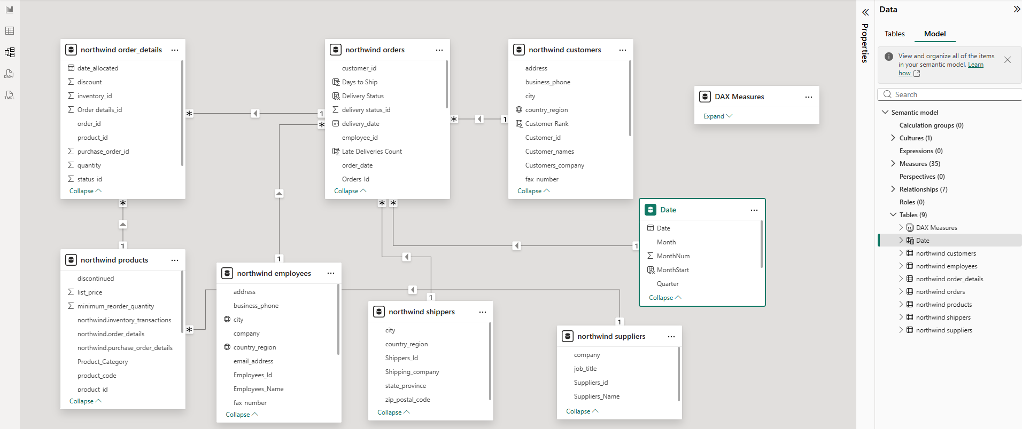
DATA MODEL
Data Sources
Orders
Order Details
Customers
Products
Employees
Shippers
Date
Dax Measures

Slide 10
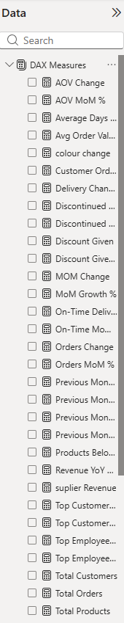
DAX MEASURES(Data Analysis Expressions)
DAX Measures
Created to calculate key business metrics like total revenue, orders, and average order value.
Built to work dynamically with filters and user interactions in the dashboards.
Enables real-time analysis of trends, comparisons, and performance insights.
Ensures accurate, actionable information for decision-making.

Slide 11
DASHBOARDS
Dashboards were built in Power BI to provide clear, interactive insights for decision-making. Data from Northwind database was connected and modeled, key metrics were visualized using charts and KPI cards, and interactive filters were added. The result is an easy to use set of dashboards that lets users quickly explore business performance and make data based informed decisions.
Sales Executives Overview ↓ Customer & Sales Representative Performance ↓ Products & Inventory Analysis ↓ Operations & Logistics Analysis

Slide 12
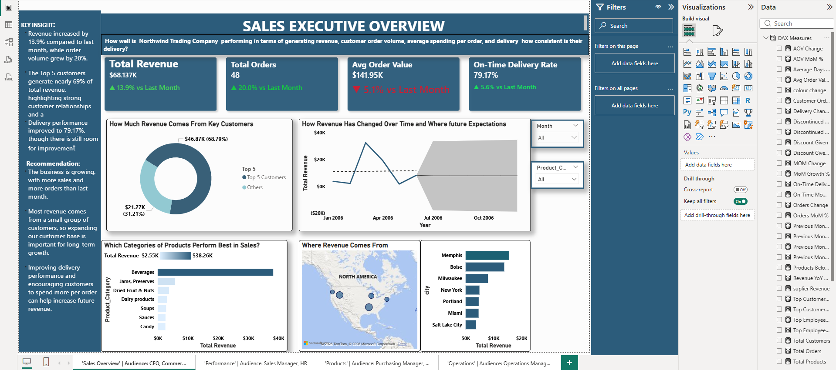
SALES EXECUTIVE OVERVIEW
KEY INSIGHT:
The Overall business performance is strong, with total revenue increase by 13.9% and orders up 20% compared to previous month.
However, the average order value has slightly decreased at 5% indicating customers are placing smaller orders.
Top 5 customers contribute nearly 69% of revenue, highlighting customer concentration. Management should focus on upselling, expanding high value customer relationships, and balancing revenue across more clients to sustain growth.

Slide 13
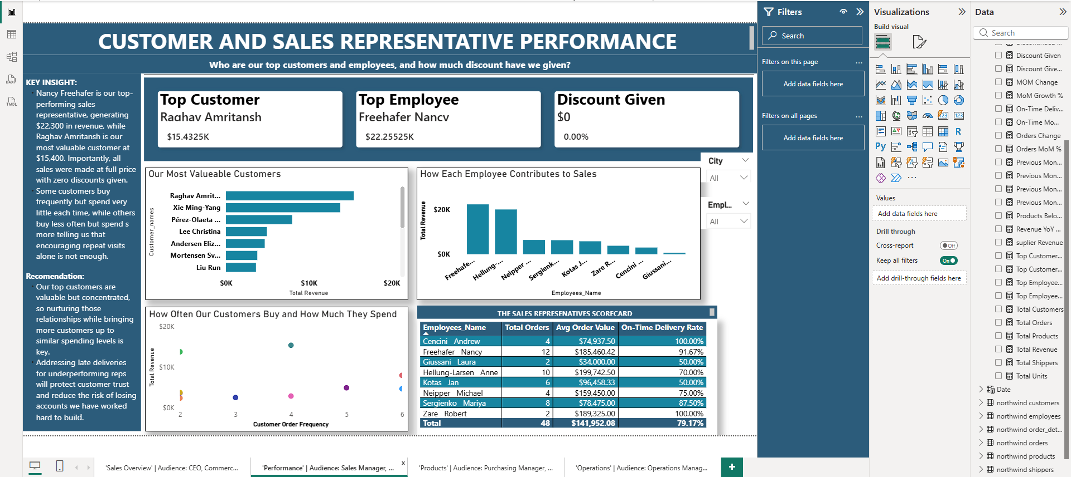
CUSTOMER AND SALES REPRESENTATIVE PERFORMANCE
KEY INSIGHT:
Revenue is heavily driven by a few key customers and top performing sales representatives, with Raghav Amritansh and Nancy Freehafer leading in value.
This concentration indicates dependency risk and uneven performance across the team.
To improve stability, the company should implement customer loyalty programs, nurture mid-tier accounts, and provide coaching and development for underperforming sales reps and having one on one conversations with them.

Slide 14
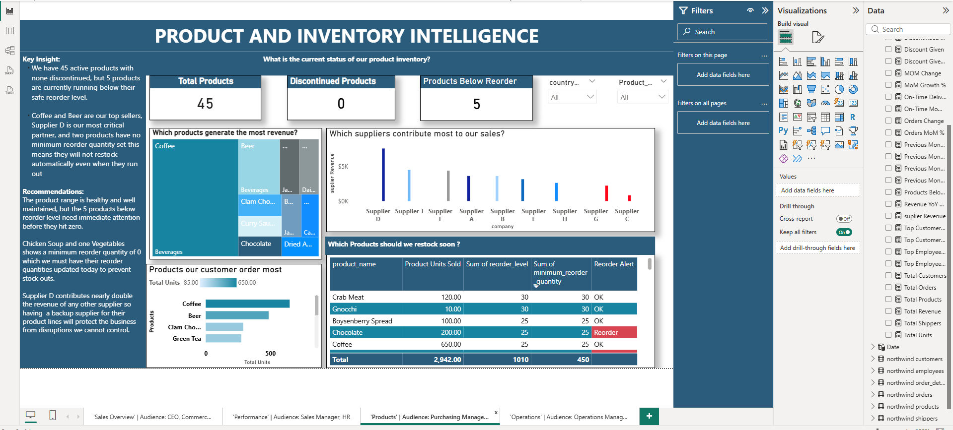
PRODUCT AND INVENTORY INTELLIGENCE
KEY INSIGHT
We have 45 active products with none discontinued, but 5 products are currently running below their safe reorder level.
Coffee and Beer are our top sellers, Supplier D is our most critical partner, and two products have no minimum reorder quantity set this means they will not restock automatically even when they run out
The product range is healthy and well maintained, but the 5 products below reorder level need immediate attention before they hit zero.
Chicken Soup and one Vegetables shows a minimum reorder quantity of 0 which we must have their reorder quantities updated today to prevent stock outs.
Supplier D contributes nearly double the revenue of any other supplier so having a backup supplier for their product lines will protect the business from disruptions we cannot control

Slide 15
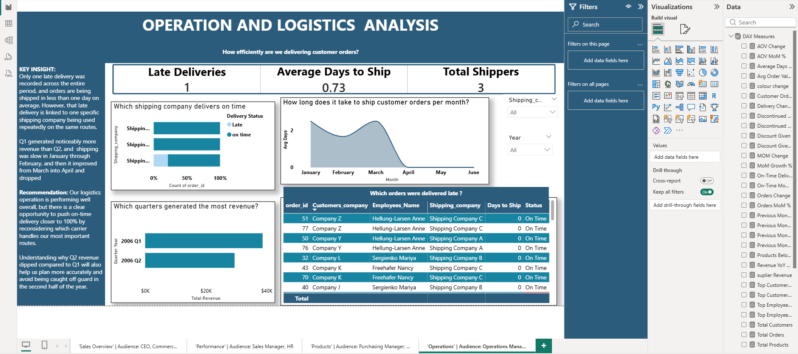
OPERATIONS AND LOGISTICS ANALYSIS
KEY INSIGHT :
The logistics operation is performing well, with orders shipped in less than one day on average and only one late delivery recorded.
The late delivery is linked to a specific carrier on repeated routes. Q1 revenue was higher than Q2, partly due to slower shipping in January and February.
To improve performance, management should review carrier allocation for critical routes and investigate the Q2 revenue decline to better support future planning and growth

Slide 16
BUSINESS ANALYSIS
The analysis shows that Northwind Traders is performing well with strong growth in revenue and order volume. Sales increased by 13.9%, while total orders increased by 20%, showing healthy customer demand. Operations are also efficient, with fast delivery times and very few late shipments, which supports good customer satisfaction.Customer and employee analysis highlights that business performance is driven by a small number of key contributors. A few customers generate a large portion of revenue, and a small group of sales representatives account for most of the sales performance. While this reflects strong relationships and high-performing staff, it also shows a dependency on limited customers and employees, which could be a risk if performance changes in the future.
The review of sales trends also shows that revenue was stronger in Q1 compared to Q2, suggesting that performance is not fully consistent throughout the year. This should be further investigated to understand what factors contributed to the decline and how future performance can be stabilized.
From a product and supply chain perspective, the business currently has 45 active products with no discontinued items, showing a stable product range. However, five products are below their safe reorder level, which requires immediate attention to prevent stock shortages. In addition, two products (including Chicken Soup and a vegetable product) have no minimum reorder quantity set, meaning they may not automatically restock when inventory runs out. This presents a risk of unexpected stockouts.
Coffee and Beer are the strongest-selling products, while Supplier D is the most critical supplier, contributing nearly double the revenue of any other supplier. While this indicates strong supplier performance, it also creates a dependency risk. If Supplier D experiences any disruption, it could significantly impact product availability. To reduce this risk, the business should consider securing backup suppliers for key product lines.
Conclusively, Power BI dashboards provide Northwind Traders with a clear and unified view of business performance across sales, customers, employees, operations, and inventory. The analysis shows strong overall growth, efficient operations, and valuable customer relationships that drive revenue.
At the same time, the findings highlight key areas for improvement, including customer concentration, performance differences across employees, seasonal fluctuations in revenue, and inventory management risks. Addressing these areas will help improve stability and reduce business risk.
The dashboards transform complex data into clear and actionable insights, enabling faster and more informed decision making. By consistently monitoring performance and improving supply chain resilience through better inventory controls and supplier diversification, Northwind Traders can strengthen long-term growth and operational stability.

